Slide 1
Pima Indian Diabetes Dataset

Slide 2
Problem identification
Challenge: Diagnosing diabetes is crucial for effective treatment and management.
Goal: improve the accuracy of diabetes diagnosis
Dataset: Pima Indian Diabetes dataset.

Slide 3
Recommendation
Importance of:
BMI
Blood pressure
Age

Slide 4
Model Results
Grid search
K-Nearest Neighbors (KNN)
Random Forest models.

Slide 5
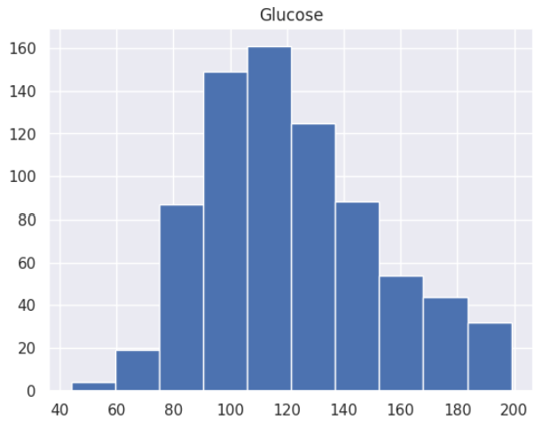
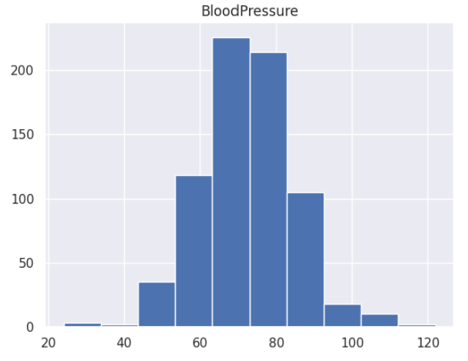
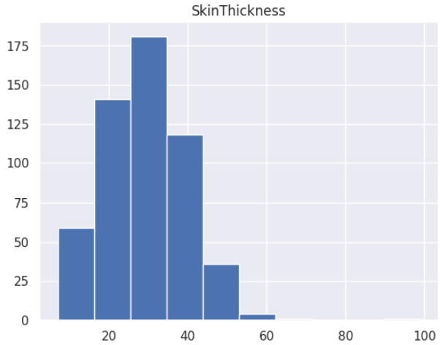
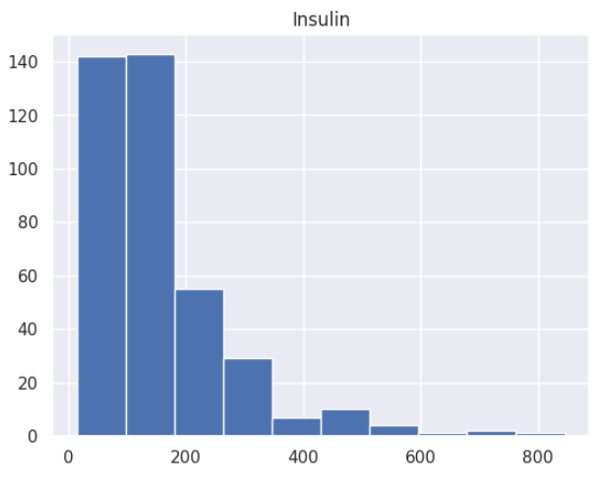
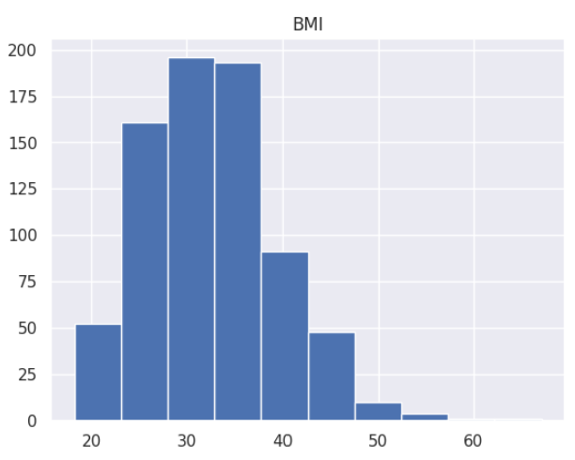
Analysis

Slide 6
Conclusion
Future Work and Impact:
Continuously refine models based on new data and insights.
Use findings to improve diagnostic accuracy and patient outcomes in diabetes prediction.

